Slide 1
HCP Journeys Why? How? When?
April ‘21

Slide 2
Why OC HCP journey are important to Galapagos ?
The traditional methods of engaging with HCPs no longer meets physician needs, and Galapagos aims to engage differently.
Galapagos is working in a highly competitive landscape, but has potential to differentiate itself by delivering a segmented HCP experience
HCP Journeys are the tool by which segmented customer experiences are designed, creating value for customers and differentiation vs competitors.
HCP Journeys are also an effective way to align the sales, marketing, and medical functions effectively, connecting strategy to execution.
Clear and consistent HCP Journeys are the foundation of more advanced marketing techniques

Slide 3








Value of the HCP Journey
HCP Journeys are the tool by which this personalisation* is designed, creating value for customers and differentiation vs competitors.
How HCP Journeys Create Value
How They Enable Launch Execution
Focusing on journeys rather than touchpoints is correlated to higher customer satisfaction & revenue growth1
OC HCP Journeys collect & visualize…
Content
What is being said to an HCP
HCPs satisfied with their journey for a drug & the pharma company’s contribution to it are 2x more likely to prescribe than dissatisfied HCPs.1
Channel
How it is being delivered
Personalization across industries reduces acquisition costs by 50% and increases efficiency of marketing spend by 10-30%.2
Adoption Ladder
When it should be said
Segmentation
How this varies between HCPs
Customers gain the ability to see the right information at the right time, in their preferred channel
…Into one executable view
McKinsey - From product to customer experience: The new way to launch in pharma
McKinsey- Marketing’s Holy Grail: Personalization at Scale
*Personalisation here is defined as the ability to deliver on segmented engagements, meaning the message, timing and channel is tailored to each HCP.
Notes:
HCP journeys are the tool by which you design personalized customer engagements to unlock value at J launch
Move VALUE to the right – have three value for galap in one color, value for customers in another color
How does the journey unlock value: Journeys provide visualization of channels, content, adoption ladder into one executable view.

Slide 4
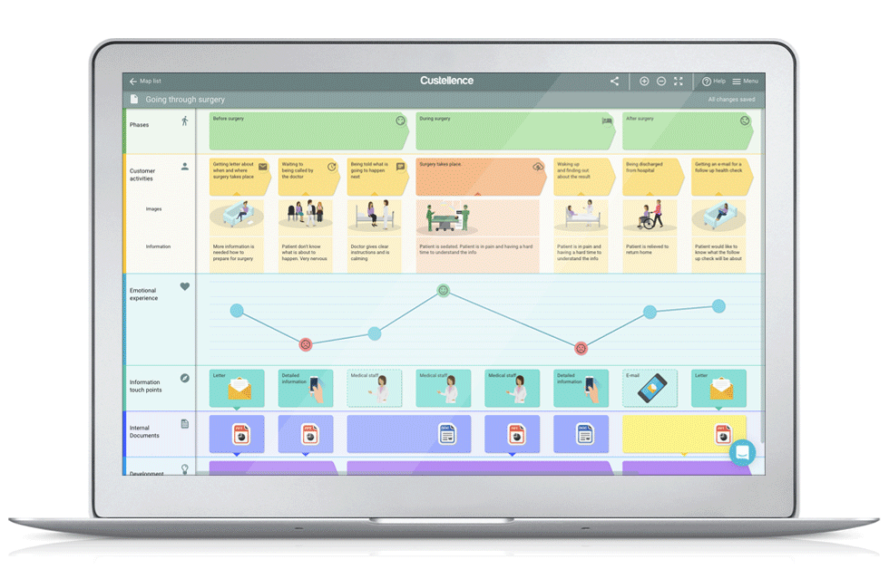

Value of the HCP Journey
HCP Journeys are also an effective way to align the sales, marketing, and medical functions effectively, connecting strategy to execution.
Sales
Medical
Marketing
The also demonstrate How to leverage the core channels, how to increase the number of touchpoints for improved SOV, and how to connect the physical and digital
HCP Journey
Illustrative
Having less resources than many competitors, we need to be much more accurate with our engagements in order to achieve these goals, the HCP Journey helps us to do this.

Slide 5

Why are HCP Journeys needed now?
The implications of not creating HCP Journeys now are substantial
Decreases potential for a successful JYSELECA performance
Galapagos only has one chance to succeed with JYSELECA, and the use of HCP Journeys enables personalized HCP engagement, which stands as the best opportunity to differentiate against Galapagos’ heavily resourced competitors.
Prohibits intelligent marketing advancements
Clear and consistent HCP Journeys are the foundation of more advanced marketing techniques, such as automation, Next Best Action, and true data-driven marketing at scale.

Slide 6
Building country specific Omnichannel HCP Journeys to support Jyseleca

Slide 7

HCP Journeys Project
Jyseleca currently has a foundation of strategic planning related to customer engagement activities for launch, including detailed segmentation and market research.
A core team with the support of Veeva, are now focused on making the plan a reality, by converting these foundations into HCP Journeys that are practical and actionable at the local level to secure competitive share of voice and achieve success.

Slide 8
The international team would like to support you in developing omnichannel customer journeys for your market
We are starting a rapid, focused project to co-create pragmatic, executable, local Customer Journeys that will help drive superior HCP experiences
International Journeys delivered by end of April
Detailed market Journeys to be delivered by end of May (to be discussed)
*Country-specific - See project plan for detailed schedule

Slide 9

What will you get at the end?
A clear, 12-month* Customer Journey for your market, for RA/IBD indication, linked to driving HCPs up the initial stages in the adoption ladder
Journeys that are linked to content both existing and currently in production for launch, with easy access to the materials needed for execution (and view on planned content)
An easy-to-use Customer Journey format, to enable dynamic updates throughout the year
*length is an estimate, journeys will likely be more focused around adoption stage TBD during week 1
**See project plan for market and indication delivery details

Slide 10
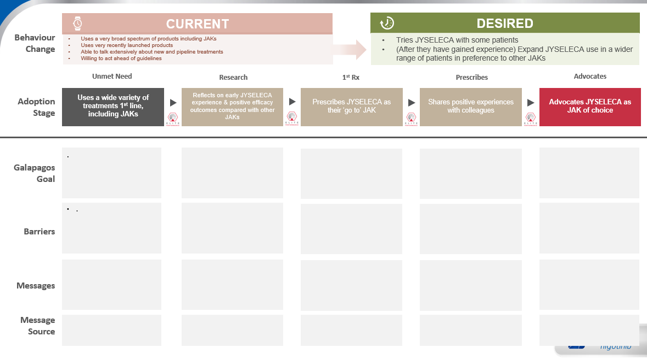
How do we get there: The Process
1
2
Adoption Ladder
HCP Journeys
The HCP-focused mapping of the level of product adoption.
The execution-focused mapping of the touchpoints with a HCP.

Slide 11
The project plan detail
March |  |  | April | April |  |  | May | May
15 | 22st (1) | 29th (2) | 5th (3) | 12th (4) | 19th (5) | 26th (6) | 3rd (7) | 10th (8) | 17th (9) | 24th (10)
Phase 1a
Customer Journey Foundations
Phase 1b
Build & Test international RA/IBD Customer Journey
Phase 1c
Detailed localization of RA/IBD Customer Journeys for large countries
Phase 1d
Localisation for smaller markets
Core project team
Core Team + International project team
Core Team
+
International project team +
2 Market Representatives
France (RA)
Team
NL
UK (RA&IBD)
BelLux
For discussion
Spain (RA)
Germany (RA&IBD)
Italy (RA)
For discussion
Format
Working sessions
4 x 2-hour sessions
Working sessions
IBD → 2 x 2-hour sessions
RA → 2 x 2-hour sessions
We will be facilitating multiple workshops within your countries
to support the development of your local CJ
Countries: 2-3x two-hour workshops,
Journey Templates & Framework
Draft Adoption Pathways & Customer Journeys
Populated International Adoption Journey + International Customer Journeys
Local Adoption Journeys & Customer Journeys
+
Training & eLearning module
Outputs
Today
Market Introduction Meeting
Scheduled Market Workshop

Slide 12
Engagement with a FR/UK/DE/ES/IT
Workshop 1
Workshop 2
Workshop 3
2hrs
2hrs
2hrs
Who: (proposed)
The core team + Local team
Local team to include the required stakeholders to ensure accurate Journey development (Marketing / Medical / Sales)
Input:
International Adoption ladder
International Customer Journey
Local events calendar and content plans and prior work
Activity:
Working session to localise the global adoption ladder, and to localise the international HCP journey against key market events, channels and goals
Output:
Adoption Journey finalised
Draft of local HCP journey created leveraging potential existing work
Who: (proposed)
The core team + Local team
Local team to include the required stakeholders to ensure accurate Journey development (Marketing / Medical / Sales)
Input:
Local adoption ladder
Iteration #1 on HCP Journey
Activity:
Working session to iterate the local HCP journeys
Output:
Updated version of the local HCP journey
Who: (proposed)
The core team + Local team
Local team to include the required stakeholders to ensure accurate Journey development (Marketing / Medical / Sales)
Input:
Local adoption ladder
Iteration #2 HCP Journey
Activity:
Working session to finalise the local HCP journeys
Output:
Final version of the local HCP journey
For UK & Germany, where both RA & IBD journeys are being created, the workshops will be run in parallel in separate groups for each indication, with the outputs being entirely specific.

Slide 13
Appendix

Slide 14

Key Messaging per Segment
With these segments in mind, message points have been developed by segment to support their progress on the adoption ladder
Unmet Need
Research
1st Rx
Prescribes
Advocates
Adoption Stage
#1
#2
#3
#4
#5
Need for new treatment options – they already agree with this and are keen to try new options
Expose to full data esp efficacy, give opportunity to try – make it easy
Reinforce experience, share additional data freely, seed need to share with others]
Provide opportunities to share experience and discuss with others
KOL opportunities – keeping in mind loyalty can prob not be expected
Mvrks
Need for more safe treatment options that do not compromise on efficacy
Expose to full data incl safety, ref trusted peers and hands-on experience]
Advocate trial and follow up re experience and expansion of trial use
Expand patient types as experience is gained – give different ‘pegs’
Consolidate experience to lead to JAK of choice ‘peg’
Messages
Prgmts
Focus on unmet needs from a patient perspective – less from an HCP perspective
KOL/Peer perspectives on JYS safety and simplicity – ‘permission to try’
Share/encourage patient feedback, patient perspectives, PIOs
Broaden profiles for patient feedback, patient perspectives, PIOs
Consolidate experience and ptn feedback to lead to JAK of choice ‘peg’ and 1L use
Cmpsts
Note that although priority has been set for Mavericks & Pragmatists at launch, key messaging for Compassionates has been collected for future purposes.

Slide 15


DESIRED
1
Behaviour Change
CURRENT
Uses a very broad spectrum of products including JAKs
Uses very recently launched products
Able to talk extensively about new and pipeline treatments
Willing to act ahead of guidelines
Tries JYSELECA with some patients
(After they have gained experience) Expand JYSELECA use in a wider range of patients in preference to other JAKs
Unmet Need
Research
1st Rx
Prescribes
Advocates
Adoption Stage
#1
#2
#3
#4
#5
High-Level Goal
To demonstrate that despite new treatments, unmet needs still remain, especially related to a balance of efficacy and safety
Segmented Goals
Mavericks: Uses a wide variety of treatments 1st line, including JAKs
Pragmatists: Occasionally uses JAKs but not consistently [high variation within segment – some are very high JAK users]
Compassionates: Uses a variety of products based on patient need & guideline recommendations
High-Level Goal
To ensure early positive experiences as proof of concept (and to share with peers)
Segmented Goals
Mavericks: Reflects on early JYSELECA experience & positive efficacy outcomes compared with other JAKs
Pragmatists: Attends a peer-to peer discussion with local colleagues about their experiences with JYSELECA & its safety profile
Compassionates: Attends a discussion with local expert about their experiences with JYSELECA & its safety profile
High-Level Goal
To differentiate JYSELECA versus other JAKs, especially RINVOQ
Segmented Goals
Mavericks: Prescribes JYSELECA as their ‘go to’ JAK
Pragmatists: Prescribes JYSELECA for some patients where safety is the main concern
Compassionates: Prescribes JYSELECA for some patients where safety & simplicity are important
High-Level Goal
To create an environment that facilitates exchange of positive experiences
Segmented Goals
Mavericks: Shares positive experiences with colleagues
Pragmatists: Gains depth of experience in patients where safety is a concern
Compassionates: Monitors feedback & safety signals in JYSELECA patients
High-Level Goal
To identify, support, and create a platform for JYSELECA advocates
Segmented Goals
Mavericks: Advocates JYSELECA as JAK of choice
Pragmatists: Expands the use of JYSELECA to different types of patients so ultimately JYSELECA becomes JAK of choice
Compassionates: Starts to use JYSELECA as first line JAK inhibitor
Galapagos Goal
1
3
2
3
1
2
1
2
1
1
2
3
3
2
3
Currently Unsegmented Barriers
Satisfied with current options
Complacency/habit
Don’t believe there are significant unmet needs that can be addressed by (another) JAK
Believe another MOA will be needed to address unmet needs
Communication gap between patients and HCPs that masks unmet needs/treatment gaps (especially Compassionates)
CoVid context : access challenge to care
Highly competitive environment with comparisons between treatments hard to make.
Treatment inertia and need to overcome mindset shift
Currently Unsegmented Barriers
Awareness & Access
Access to JYSELECA
Lack of access to sampling
Lack of experience with JYSELECA
Lack of familiarity with Galapagos and new relationship with reps
Differentiation
Perceived lack of differentiation from RINVOQ
Sees no difference in clinic relative to RINVOQ
Negative Safety Halo
Residual JAK concerns from 1st generation
Clinical
Has a negative experience in a patient in first few patients
Lack of clarity of who the ideal JYSELECA patient is
Currently Unsegmented Barriers
Satisfaction with their current JAK and no reason to change
Prefer to have a wide armamentarium, rather than a go-to
Like to keep options open as new entries emerge
Competitive messaging and share of voice
Uncertainty around available JYSELELCA support services for HCPs and patients
Unsure of which patient population to expand usage in
Currently Unsegmented Barriers
Negative experiences that temper their enthusiasm
Wanting to appear unbiased/unaligned with a brand
Currently Unsegmented Barriers
Do not have a JAK of choice and philosophically opposed to aligning with one product
Don’t have a platform from which to advocate
Barriers
Notes:
#1
Mavericks lowest priority as they will already try new things on their own.
Pragmatists are using JAKs so we need to demonstrate that there is still a need for a new/different JAKi
#2
Mavericks are most likely be early adopters and also share their experience so we want to ensure they have early positive experience
Pragmatists tend to bend the rules to solve problems, focusing on safety provides a strong reason to believe
Compassionates will want to hear from and be reassured by peers so important to get the other two comfortable first
#3
Pragmatists most concerned with safety – need to differentiate on safety to achieve earlier us and differentiate against RINVOQ
Mavericks third because they will try anyway and also form their own opinion
#4 and #5
Pragmatists first because they are more likely to be long-term advocates
Mavericks second because want to keep them interested in JYSELECA by giving them a platform but they may move on to other products
Compassionates last because they will wait to hear from M and P – so we need M and P on board and sharing their stories

Slide 16
DESIRED
1
Behaviour Change
CURRENT
Uses a very broad spectrum of products including JAKs
Uses very recently launched products
Able to talk extensively about new and pipeline treatments
Willing to act ahead of guidelines
Tries JYSELECA with some patients
(After they have gained experience) Expand JYSELECA use in a wider range of patients in preference to other JAKs
Unmet Need
Research
1st Rx
Prescribes
Advocates
Adoption Stage
#1
#2
#3
#4
#5
Message Objective by Segment:
Mavericks: significant need for new treatment options – they already agree with this and are keen to try new options, esp if efficacy is not compromised
Pragmatists: need for more safe treatment options that do not compromise on efficacy
Compassionates: focus on unmet needs from a patient perspective – less from an HCP perspective
Message Topics:
Unmet needs messaging : 1/3 patients are refractory, EULAR guidelines, (5messages in total)
FAQ on CoVid impact
Message Objective by Segment:
Mavericks: expose to full data esp efficacy, give opportunity to try – make it easy, but they will be interested
Pragmatists: expose to full data incl safety, ref trusted peers/colleagues and hands on experience
Compassionates: KOL/Peer/trusted source perspectives on JYS safety and simplicity – ‘permission to try’
Message Topics
Now available
MoA : selectivity (vs 1G)
Comprehensive clinical evidence : 3 CT and long term data
Strength of balance story : full strength with safety)
Reimbursement : (to be localised)
Patient identification
HCP and Patient Support Service (Cpst) / to be localised)
Message Objective by Segment:
Mavericks: reinforce experience, share additional data freely, seed need to share with others
Pragmatists: advocate trial and follow up re experience and expansion of trial use
Compassionates: share/encourage patient feedback, patient perspectives, PIO
Message Topics
Efficacy
Safety
Patient Profiles
Patient identification
Corporate support
HCP and Patient Support Service
Message Objective by Segment:
Mavericks: provide opportunities to share experience and discuss with others
Pragmatists: expand patient types as experience is gained – give different ‘pegs
Compassionates: Monitors feedback & safety signals in JYSELECA patients
Message Topics
Efficacy
Safety
Patient Profiles
Patient identification
Corporate support
HCP and Patient Support Service
Message Objective by Segment:
Mavericks: KOL opportunities – keeping in mind loyalty can prob not be expected
Pragmatists: consolidate experience to lead to JAK of choice ‘peg’]
Compassionates: consolidate experience and ptn feedback to lead to JAK of choice ‘peg’ and 1L use
Message Topics
Corporate support
HCP and Patient Support Service
Partnership opportunities
Messages
Message Source
Please refer to Brand Content Asset Overview
Please refer to Brand Content Asset Overview
Please refer to Brand Content Asset Overview
Please refer to Brand Content Asset Overview
Please refer to Brand Content Asset Overview

Slide 17
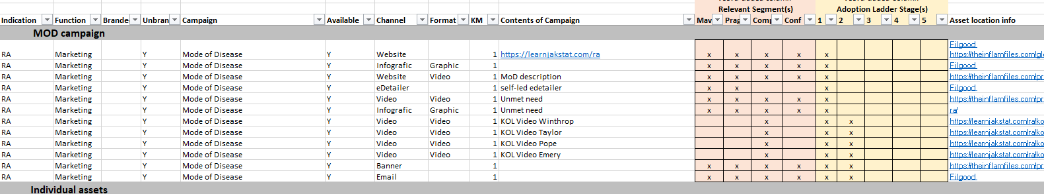
Existing Content
Assets developed or in progress by the international team are designed to meet RA JYSELECA objectives and convey key messages. As key messages are aimed at specific segments, assets are therefore segmented as well.
Mapping Assets to Segments & Adoption Ladder Stages
Currently a mapping process is underway to identify which segments are the most appropriate recipients of individual assets.
This file once completed will allow for local users to search the current content library for assets based on the relevant segment & adoption ladder stages they need.
*Please note that the image above is illustrative & intended to convey the process used to map content. Content mapping has not been finalized and thus the mapping shown above is subject to change.

Slide 18
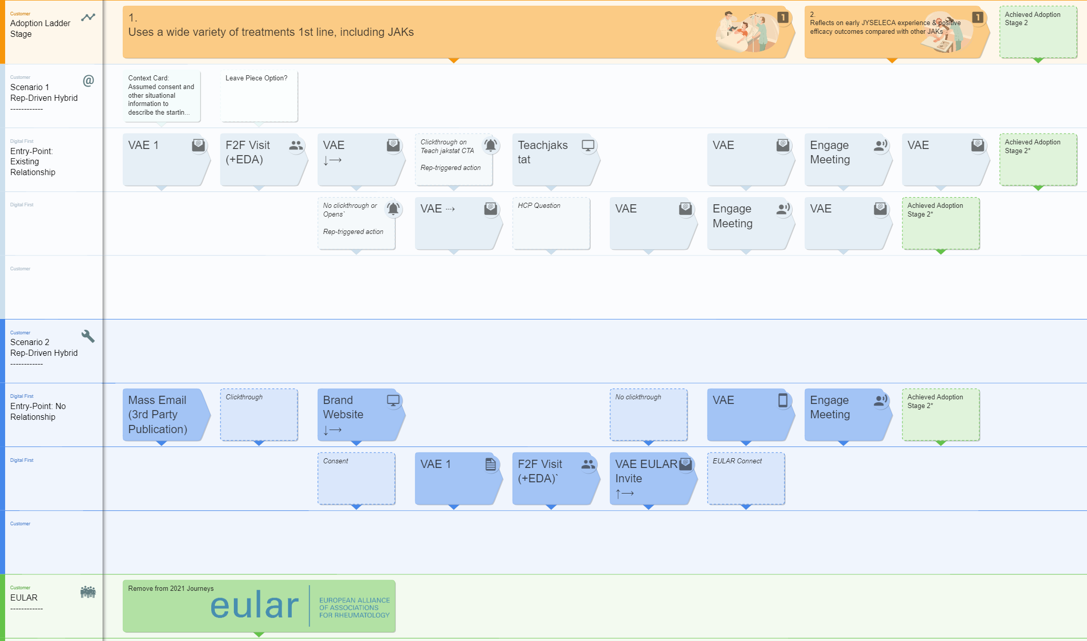
How do we get there: The HCP Journey Map
2
Structured by Adoption Ladder Stage
Entry Point Scenarios
Different entry-points (e.g. Existing Relationship, Digital-only) necessitate specified journeys
Content Boxes
Each box represents assets, selected and organized with the goal of moving an HCP up the adoption ladder.
DRAFT

Slide 19
Engagement with a NL/BNL
Week 1
Week 2
Workshop 1
Workshop 2
2hrs
2hrs
Who: (proposed)
The core team + Local team
Local team to include the required stakeholders to ensure accurate Journey development (Marketing / Medical / Sales)
Input:
International adoption ladder
International HCP journey
Local events calendar and content plans
Journeys produced in 2020
Activity:
Working session to localise the global adoption ladder, and localising the international HCP journey against key market events, channels and goals
Output:
Adoption Journey finalised
Updated local HCP journey created
Who: (proposed)
The core team + Local team
Local team to include the required stakeholders to ensure accurate Journey development (Marketing / Medical / Sales)
Input:
Local adoption ladder
Workshop 2 HCP journey
Activity:
Working session to finalise the local HCP journeys
Output:
Final version of the local HCP journey

Slide 20
Project Phases
March |  |  | April | April |  |  | May | May
15 | 22st (1) | 29th (2) | 5th (3) | 12th (4) | 19th (5) | 26th (6) | 3rd (7) | 10th (8) | 17th (9) | 24th (10)
Project Management
Create Customer journey maps
1
Phase 1b
Build & Test Regional HJ Maps
Phase 1c
Detailed Localization of HJ Maps for France, Germany, UK, Spain, Italy
Phase 1d
Finalized Localization of HJ for NL and BelLux
Phase 1a
Foundations for HCP J Maps
Align maps with CRM/CDP
2
Phase 2a
Define Alignment between CJ Maps & CRM/CDP
Phase 2b
Build action plan to operationalize alignment
Mobilization
Build HCP journey map understanding
3
Phase 3a
Build Tactic Plan
Phase 3b
Build e-learning module
Phase 3c
Train the Trainer (CJ Market Champions)

Slide 21



An experienced Veeva team will helps us achieve our goals and will be supporting you
CORE DELIVERY TEAM
SME
Louisa Peacock
Veeva Lead
Alexandre Raynaud
CJ Architect
Gareth Allot
Engagement Manager
Alex Richwood
Business Consultant
Aaron Bean
VP, Business Consulting Lead
Europe BC Head
Brings deep LS Expertise and 8+ years defining Commercial Strategy and Operating Models
Louisa has worked with large enterprise Pharma in defining and executing on Commercial and Medical models including omni-channel orchestration and go to market engagement models.
Prior to joining Veeva she worked at EY and Accenture consulting where she worked in the US and Europe on complex multi geography / functional LS teams. Clients include Astellas, AZ, BMS, Takeda, Merck.
Brings expertise in designing Customer journeys with Galapagos France
Alexandre Leads Veeva's Business Consulting Practice in France and specialises in commercial excellence, innovation and digital transformation.
He brings 15 years' experience in marketing and sales functions both at affiliate and global level, working across the drug lifecycle and 7 therapeutic areas, including at Lilly.
Brings extensive experience designing and operationalizing Commercial Models
Gareth has deep experience in the execution of omni-channel and leads on engagements across Europe in Field Force optimization and Veeva Pulse. being passionate about providing data driven insights.
Prior to joining Veeva Gareth worked in Accenture consulting’s HLS practice, leading multi market global commercial programs
Brings Field Force sizing, modelling and analytic capability
Alex has joined Veeva having recently completed an MBA at HEC Paris.
He has supported projects in sales force efficiency and optimization, providing market research, data and analytics.
Alex joined Veeva to help define and enable the new model for the future in LS.
Aaron leads Veeva's European Business Consulting Practice and specializes in commercial excellence, innovation and digital transformation. enabling clients to design and deliver world class customer experiences
He brings over 18+ years' experience, prior to Veeva, Aaron was the Life Sciences Advisory Lead in EY UK.

